Slide 1
Conserved Protein Motif Identification
Kimiko Suzuki, Kevin McPherson, Amy Pomeroy, Miranda Lynch
UNC Computational Medicine Codeathon
3/11/2020-3/13/2020
Notes:
So this tool will be a way of visualizing sequence motifs in proteins of interest from genomic data available online.
This tool will also look at whether or not a motif of interest is conserved among a group of genomes.
The biological inference related to basic evolutionary concept where conserved sites of interest may be more important for organism fitness or proper signaling response, since that’s the field I work in.

Slide 2
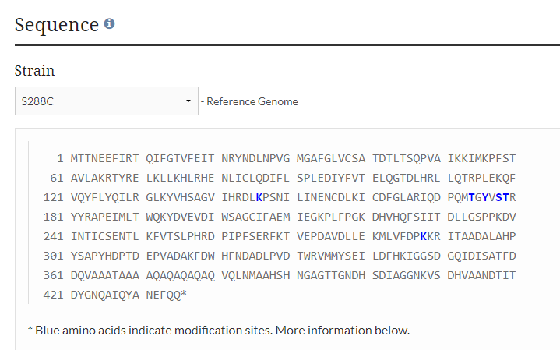
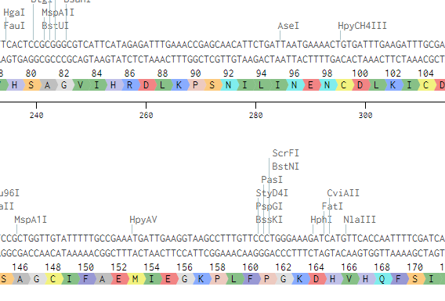

Slide 3
